Slide 1
Analysis Of Algorithms

Slide 2
Evolution Of algorithm
The first ever algorithm was proposed by Ada Lovelace Mathematician who used the concepts of zero and decimal position of number.
During the 1940’s and 1950’s research oriented towards building efficient computer system , so that they can be used in scientific, commercial engineering problems.
Structured Programming came into existence after Alan Turning introduced the idea of effective procedure in 1936.
Donald Knuth is the father of algorithms

Slide 3
What is an algorithm?
An algorithm is a sequence of unambiguous instructions for solving a problem, i.e., for obtaining a required output for any legitimate input in a finite amount of time.
Problem
Algorithm
Input
Computer
Output

Slide 4
Following are the features which an algorithm has:
Finiteness
terminates after a finite number of steps
Definiteness
rigorously and unambiguously specified
Clearly specified input
valid inputs are clearly specified
Clearly specified/expected output
can be proved to produce the correct output given a valid input
Effectiveness
steps are sufficiently simple and basic

Slide 5
Why study algorithms?
Theoretical importance
the core of computer science
Practical importance
A practitioner’s toolkit of known algorithms
Framework for designing and analyzing algorithms for new problems

Slide 6
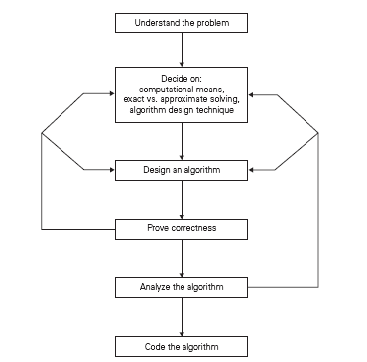
Scientific Approach For Algorithmic Problem Solving

Slide 7
Issues in the Study of Algorithms
How to create an algorithm.
How to validate an algorithm.
How to analyses an algorithm
How to test a program.

Slide 8
Cont’d …
1 .How to create an algorithm: To create an algorithm we have following design techniques
a) Divide & Conquer
b) Greedy method
c) Dynamic Programming
d) Branch & Bound
e) Backtracking
2.How to validate an algorithm: Once an algorithm is created it is necessary to show that it computes the correct output for all possible legal input , this process is called algorithm validation.

Slide 9
3. How to analyses an algorithm: Analysis of an algorithm or performance analysis refers to task of determining how much computing time & storage algorithms require.
Time complexity:- Frequency or Step count method
Space complexity:- To calculate space complexity we have to use number of input used in algorithms.
4. How to test the program: To test a program we need following
Debugging: It is processes of executing programs on sample data sets to determine whether faulty results occur & if so correct them.
Profiling or performance measurement is the process of executing a correct program on data set and measuring the time & space it takes to compute the result.

Slide 10
Example of Quick sort Algorithm using Divide-and-Conquer
Divide: Partition (separate) the array A[p..r] into two (possibly empty) subarrays A[p..q–1] and A[q+1..r].
Each element in A[p..q–1] < A[q].
A[q] < each element in A[q+1..r].
Index q is computed as part of the partitioning procedure.
Conquer: Sort the two subarrays by recursive calls to quicksort.
Combine: The subarrays are sorted in place – no work is needed to combine them.

Slide 11
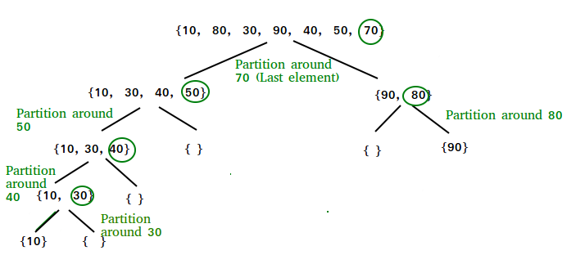
Quicksort
The key process in quick Sort is a partition(). The target of partitions is to place the pivot (any element can be chosen to be a pivot) at its correct position in the sorted array and put all smaller elements to the left of the pivot, and all greater elements to the right of the pivot.
Partition is done recursively on each side of the pivot after the pivot is placed in its correct position and this finally sorts the array.

Slide 12
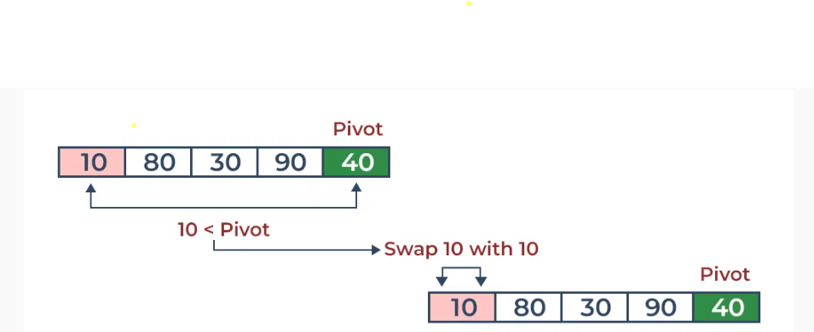
Choosing Pivot
Always pick the first element as a pivot.
Always pick the last element as a pivot
Pick a random element as a pivot.
Pick the middle as the pivot.
Consider: arr[] = {10, 80, 30, 90, 40}.
Compare 10 with the pivot and as it is less than pivot arrange it accordingly .

Slide 13
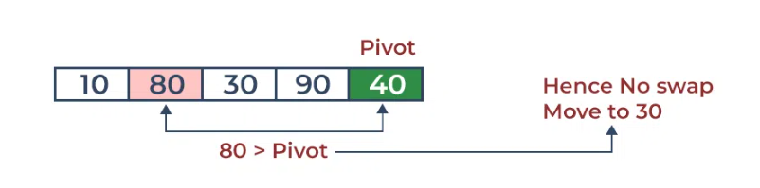
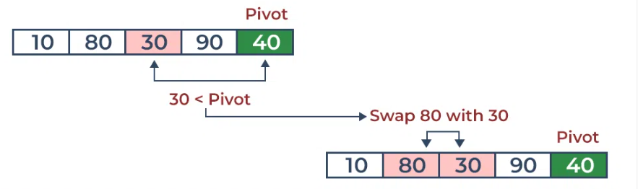
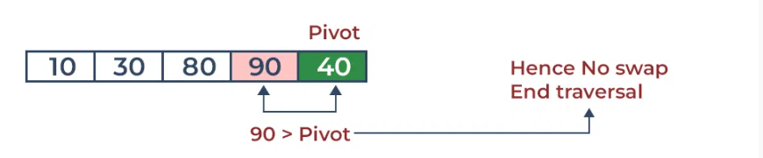
Compare 80 with the pivot. It is greater than pivot.
Compare 30 with pivot. It is less than pivot so arrange it accordingly.
Compare 90 with the pivot. It is greater than the pivot.

Slide 14
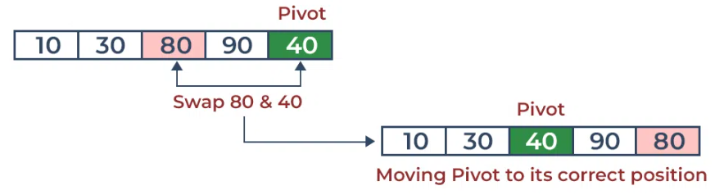
Arrange the pivot in its correct position.
As the partition process is done recursively, it keeps on putting the pivot in its actual position in the sorted array. Repeatedly putting pivots in their actual position makes the array sorted

Slide 15
Step 1 − Choose the highest index value has pivot
Step 2 − Take two variables to point left and right of the list excluding pivot Step 3 − left points to the low index
Step 4 − right points to the high
Step 5 − while value at left is less than pivot move right
Step 6 − while value at right is greater than pivot move left
Step 7 − if both step 5 and step 6 does not match swap left and right
Step 8 − if left ≥ right, the point where they met is new pivot
Pseudocode
procedure quickSort(left, right)
if right-left <= 0
return
else
pivot = A[right]
partition = partitionFunc(left, right, pivot)
quickSort(left,partition-1)
quickSort(partition+1,right)
end if
end procedure

Slide 16
Complexity Analysis of Quick Sort:
Time Complexity:
Best Case: Ω (N log (N)) The best-case scenario for quicksort occur when the pivot chosen at the each step divides the array into roughly equal halves. In this case, the algorithm will make balanced partitions, leading to efficient Sorting.
Average Case: θ ( N log (N)) Quicksort’s average-case performance is usually very good in practice, making it one of the fastest sorting Algorithm.
Worst Case: O(N2) The worst-case Scenario for Quicksort occur when the pivot at each step consistently results in highly unbalanced partitions.
Auxiliary Space: O(1), if we don’t consider the recursive stack space. If we consider the recursive stack space then, in the worst case quicksort could make O(N).

Slide 17
Mergesort
Merge sort is a sorting technique based on divide and conquer technique. With worst-case time complexity being Ο(n log n), it is one of the most used and approached algorithms.
The MergeSort function keeps on splitting an array into two halves until a condition is met where we try to perform MergeSort on a subarray of size 1, i.e., p == r.
And then, it combines the individually sorted subarrays into larger arrays until the whole array is merged.
ALGORITHM-MERGE SORT
1. If p<r
2. Then q → ( p+ r)/2
3. MERGE-SORT (A, p, q)
4. MERGE-SORT ( A, q+1,r)
5. MERGE ( A, p, q, r)
Here we called MergeSort(A, 0, length(A)-1) to sort the complete array.

Slide 18
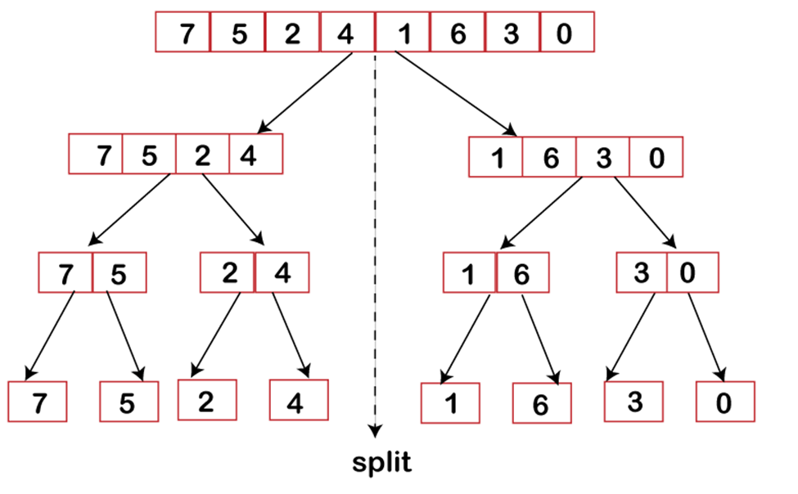
Procedure

Slide 19
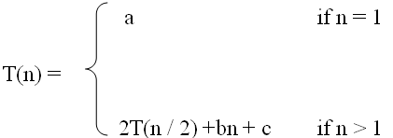
What is a recurrence relation?
A recurrence relation, T(n), is a recursive function of an integer variable n.
Like all recursive functions, it has one or more recursive cases and one or more base cases.
Example:
The portion of the definition that does not contain T is called the base case of the recurrence relation; the portion that contains T is called the recurrent or recursive case.
Recurrence relations are useful for expressing the running times (i.e., the number of basic operations executed) of recursive algorithms
.

Slide 20
Forming Recurrence Relations
For a given recursive method, the base case and the recursive case of its recurrence relation correspond directly to the base case and the recursive case of the method.
Example 1: Write the recurrence relation for the following method:
The base case is reached when n = = 0. The method performs one comparison. Thus, the number of operations when n = = 0, T(0), is some constant a.
When n > 0, the method performs two basic operations and then calls itself, using ONE recursive call, with a parameter n – 1.
public void f (int n) {
if (n > 0) {
System.out.println(n);
f(n-1);
}
}

Slide 21
Therefore the recurrence relation is:
T(0) = a for some constant a
T(n) = b + T(n – 1) for some constant b
In General, T(n) is usually a sum of various choices of T(m ), the cost of the recursive sub problems, plus the cost of the work done outside the recursive calls:
T(n ) = aT(f(n)) + bT(g(n)) + . . . + c(n)
where a and b are the number of subproblems, f(n) and g(n) are subproblem sizes, and
c(n) is the cost of the work done outside the recursive calls [Note: c(n) may be a constant]

Slide 22
Example
Example 1: Write the recurrence relation for the following method:
The base case is reached when n == 1. The method performs one comparison and one return statement. Therefore, T(1), is some constant c.
When n > 1, the method performs TWO recursive calls, each with the parameter n / 2, and some constant # of basic operations.
Hence, the recurrence relation is:
T(1) = c for some constant c
T(n) = b + 2T(n / 2) for some constant b
public int g(int n) {
if (n == 1)
return 2;
else
return 3 * g(n / 2) + g( n / 2) + 5;
}

Slide 23
Different types of recurrence relations
Type 1: Divide and Conquer Recurrence Relations:
Following are some of the examples of recurrence relations based on divide and conquer.
T(n) = 2T(n/2) + cn T(n) = 2T(n/2) + √n
These types of recurrence relations can be easily solved using Master Method
For recurrence relation T(n) = 2T(n/2) + cn, the values of a = 2, b = 2 and k =1. Here logb(a) = log2(2) = 1 = k. Therefore, the complexity will be Θ(nlog2(n)). Similarly for recurrence relation T(n) = 2T(n/2) + √n, the values of a = 2, b = 2 and k =1/2. Here logb(a) = log2(2) = 1 > k. Therefore, the complexity will be Θ(n).

Slide 24
Type 2: Linear Recurrence Relations:
Following are some of the examples of recurrence relations based on linear recurrence relation.
T(n) = T(n-1) + n for n>0 and T(0) = 1
These types of recurrence relations can be easily solved using substitution method
For example,
T(n) = T(n-1) + n = T(n-2) + (n-1) + n = T(n-k) + (n-(k-1))….. (n-1) + n
Substituting k = n, we get
T(n) = T(0) + 1 + 2+….. +n = n(n+1)/2 = O(n^2)

Slide 25
Type 3: Value Substitution Before Solving:
Sometimes, recurrence relations can’t be directly solved using techniques like substitution, recurrence tree or master method. Therefore, we need to convert the recurrence relation into appropriate form before solving. For example,
T(n) = T(√n) + 1
To solve this type of recurrence, substitute n = 2^m as:
T(2^m) = T(2^m /2) + 1 Let T(2^m) = S(m), S(m) = S(m/2) + 1
Solving by master method, we get
S(m) = Θ(logm) As n = 2^m or m = log2(n), T(n) = T(2^m) = S(m) = Θ(logm) = Θ(loglogn)

Slide 26
Telescoping in DAA
Telescoping is a technique used in the analysis of algorithms to simplify the computation of sums and integrals. It is particularly useful when the summands or integrands have a recursive structure. Creative telescoping is a powerful computer algebra paradigm for dealing with definite integrals and sums with parameters.
The complexity of telescoping is a topic in mathematics that deals with the computational complexity of the creative telescoping method for definite integration of special functions. The goal is to obtain fast algorithms and implementations for definite integration of general special functions, in a complexity-driven perspective.

Slide 27

Master Theorem (Master Method)
The master method provides an estimate of the growth rate of the solution for recurrences of the form:
where a ≥ 1, b > 1 and the overhead function f(n) > 0
It is used for calculation of time complexity. Only specific recurrence relations can be solved using master theorem.
If T(n) is interpreted as the number of steps needed to execute an algorithm for an input of size n, this recurrence corresponds to a “divide and conquer” algorithm, in which a problem of size n is divided into a sub-problems of size n / b, where a, b are positive constants:

Slide 28
Example1: Find the big-Oh running time of the following recurrence. Use the Master
Theorem:
T(1) = 1
T(n) = 2T(n / 2) + n
Solution: a = 2, b = 2, c = 1 → a = b^{c} → Case 2
Hence T(n) is O(n log n)
Example2: Find the big-Oh running time of the following recurrence. Use the Master
Theorem:
T(1) = 1
T(n) = 4T(n / 2) + kn³ + h where k ≥ 1 and h ≥ 1
Solution: a = 4, b = 2, c = 3 → a < b^{c} → Case 3
Hence T(n) is O(n³)

Slide 29
MCQ’S for Week 1
Question 1: What is the time complexity of the following code snippet?
for i in range(n): print("Hello, World!")
a) O(1) b) O(n) c) O(log n) d) O(n^2)
Question 2: What is the space complexity of the following code snippet?
def find_max(arr): max_value = arr[0] for element in arr: if element > max_value: max_value = element return max_value
a) O(1) b) O(n) c) O(log n) d) O(n^2)
Question 3: What is the time complexity of the following code snippet?
for i in range(n): for j in range(n): print(i, j)
a) O(1) b) O(n) c) O(n^2) d) O(log n)
Question 4: What is the space complexity of the following code snippet?
def fibonacci(n): fib = [0] * (n+1) fib[0], fib[1] = 0, 1 for i in range(2, n+1): fib[i] = fib[i-1] + fib[i-2] return fib[n]
a) O(1) b) O(n) c) O(log n) d) O(n^2)
Question 5: What is the time complexity of the binary search algorithm?
a) O(1) b) O(log n) c) O(n) d) O(n^2)

Slide 30
Question 6: What does Big O notation represent in terms of algorithm analysis?
a) Best-case time complexity b) Average-case time complexity c) Worst-case time complexity d) Exact running time
Question 7: If a function f(n) is O(g(n)), what does it imply?
a) f(n) grows faster than g(n) b) f(n) grows at the same rate as g(n) c) f(n) grows slower than g(n) d) No relationship between f(n) and g(n)
Question 8: What does Big Omega (Ω) notation represent in terms of algorithm analysis and : If f(n) = Θ(g(n)), what does it mean?
a) Best-case time complexity b) Average-case time complexity c) Worst-case time complexity d) Lower bound on the growth rate of a function
Question 9: If f(n) = Θ(g(n)), what does it mean?
a) f(n) grows faster than g(n) b) f(n) grows at the same rate as g(n) c) f(n) grows slower than g(n) d) No relationship between f(n) and g(n)
Question 10: Which of the following statements is true regarding Big O notation?
a) f(n) = O(g(n)) implies g(n) = O(f(n)) b) f(n) = O(g(n)) implies g(n) = Ω(f(n)) c) f(n) = Θ(g(n)) implies g(n) = O(f(n)) d) f(n) = Ω(g(n)) implies g(n) = Θ(f(n))

Slide 31
Question 13. Which Design algorithm technique is used for quick sort?
Divide and conquer
Greedy
Backtrack
Dynamic programming
Question 14. The time complexity of quicksort is ……..
O(n)
O(logn)
O(n2)
O(n logn)
Question 15. Which of the following sorting algorithms provide the best time complexity in the worst-case scenario?
Merge Sort
Quick Sort
Bubble Sort
Selection Sort

Slide 32
Question 11. What is the value of following recurrence.
T(n) = T(n/4) + T(n/2) + cn2
T(1) = c
T(0) = 0
Where c is a positive constant
O(n3)
O(n2)
O(n2 Logn)
O(nLogn)
Question 12. What is the time complexity of following code:
int i, j, k = 0;
for (i = n / 2; i <= n; i++) {
for (j = 2; j <= n; j = j * 2) {
k = k + n / 2;
}
}
O(n)
O(nLogn)
O(n^2)
O(n^2Logn)

Slide 33
Answers
Question 1: Solution: b) O(n)
Question 2: Solution: O(1)
Question31: Solution: c) O(n^2)
Question 4: O(n)
Question 5: Solution: b) O(log n)
Question 6: Solution: b) O(n)
Question 7: Solutio Worst-case time complexity
Question 8: f(n) grows at the same rate as g(n)
Question 9: f(n) = Θ(g(n)) implies g(n) = O(f(n))
Question 10:

Slide 34
Question 11: O(n2)
Question 12: O(nLogn)
Question 13: Divide and Conquer
Question 14: O(n logn)
Question 15: Merge Sort

Slide 35
Find the big-Oh running time of the following recurrence. Use the Master
Theorem:
T(1) = 1
T(n) = 2T(n / 2) + n
Example2: Find the big-Oh running time of the following recurrence. Use the Master
Theorem:
T(1) = 1
T(n) = 4T(n / 2) + kn³ + h where k ≥ 1 and h ≥ 1

